Slide 1

To-Do List Web Application
Yashwanth B N

Slide 2
Introduction
A simple yet effective web application designed to help users manage their tasks and stay organized.
Developed using standard web technologies such as HTML, CSS, and JavaScript, making it lightweight and easily accessible.
Provides a clean and intuitive user interface for adding, editing, and removing tasks.

Slide 3
Working
Input Task: Users enter their tasks into the provided text input field.
Add Task: Clicking the "Add" button dynamically adds the task to the list, visible immediately to the user.
Manage Tasks: Each task item includes options to mark it as completed or delete it, providing simple task management capabilities.

Slide 4
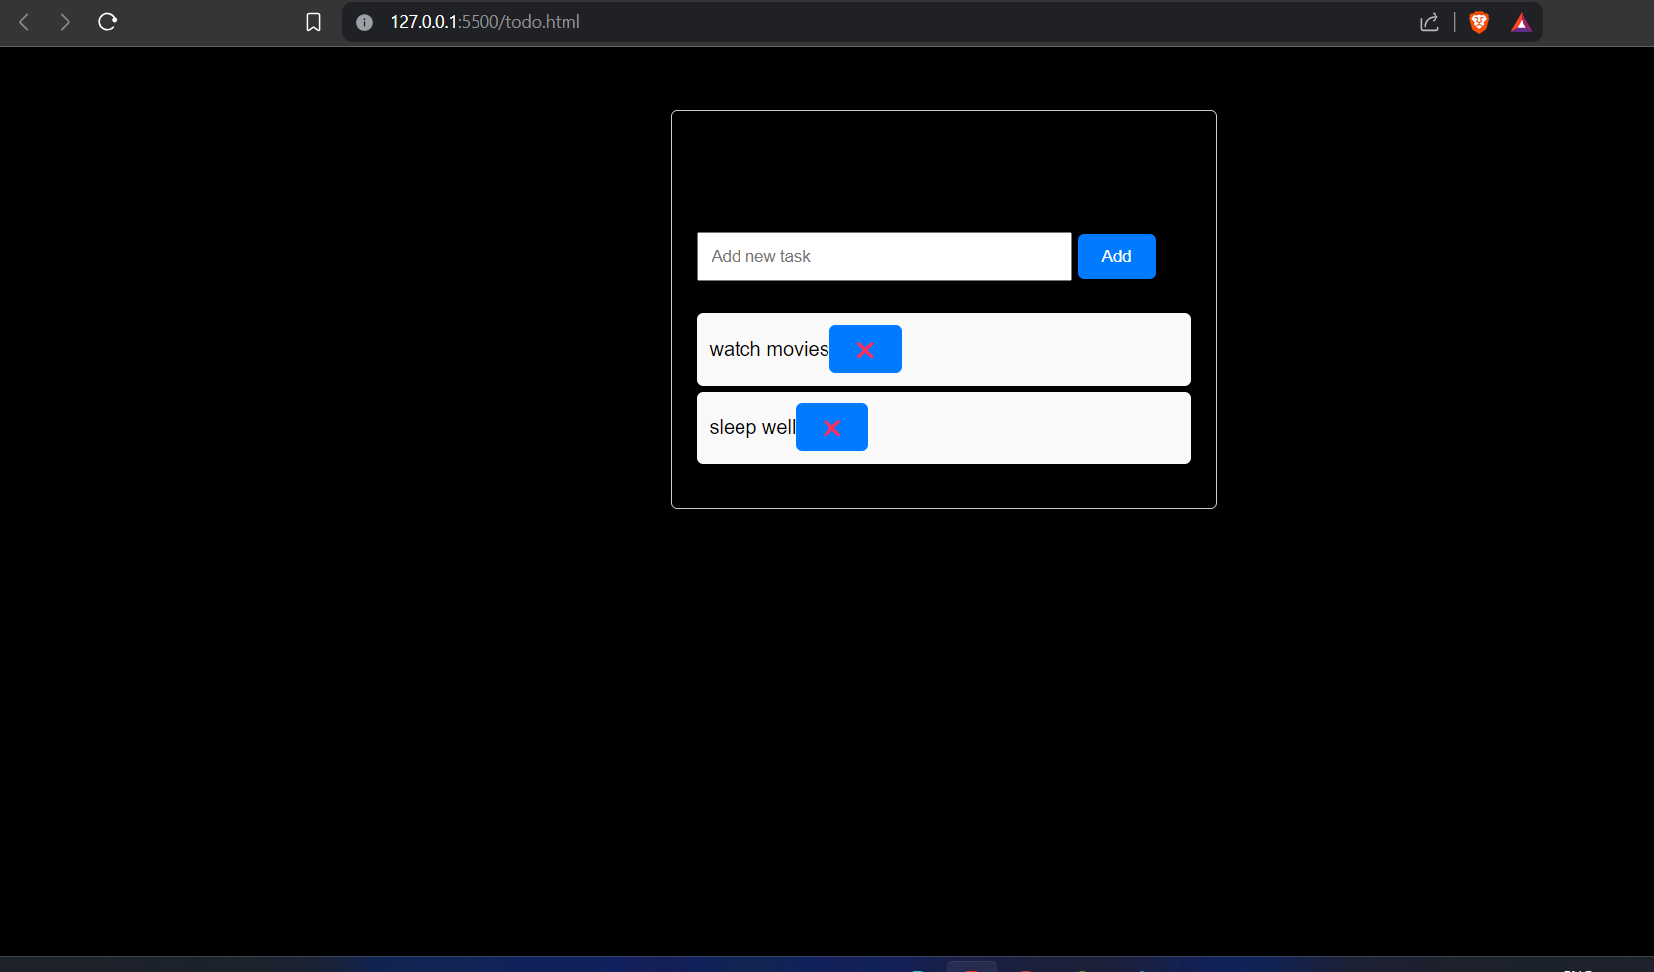
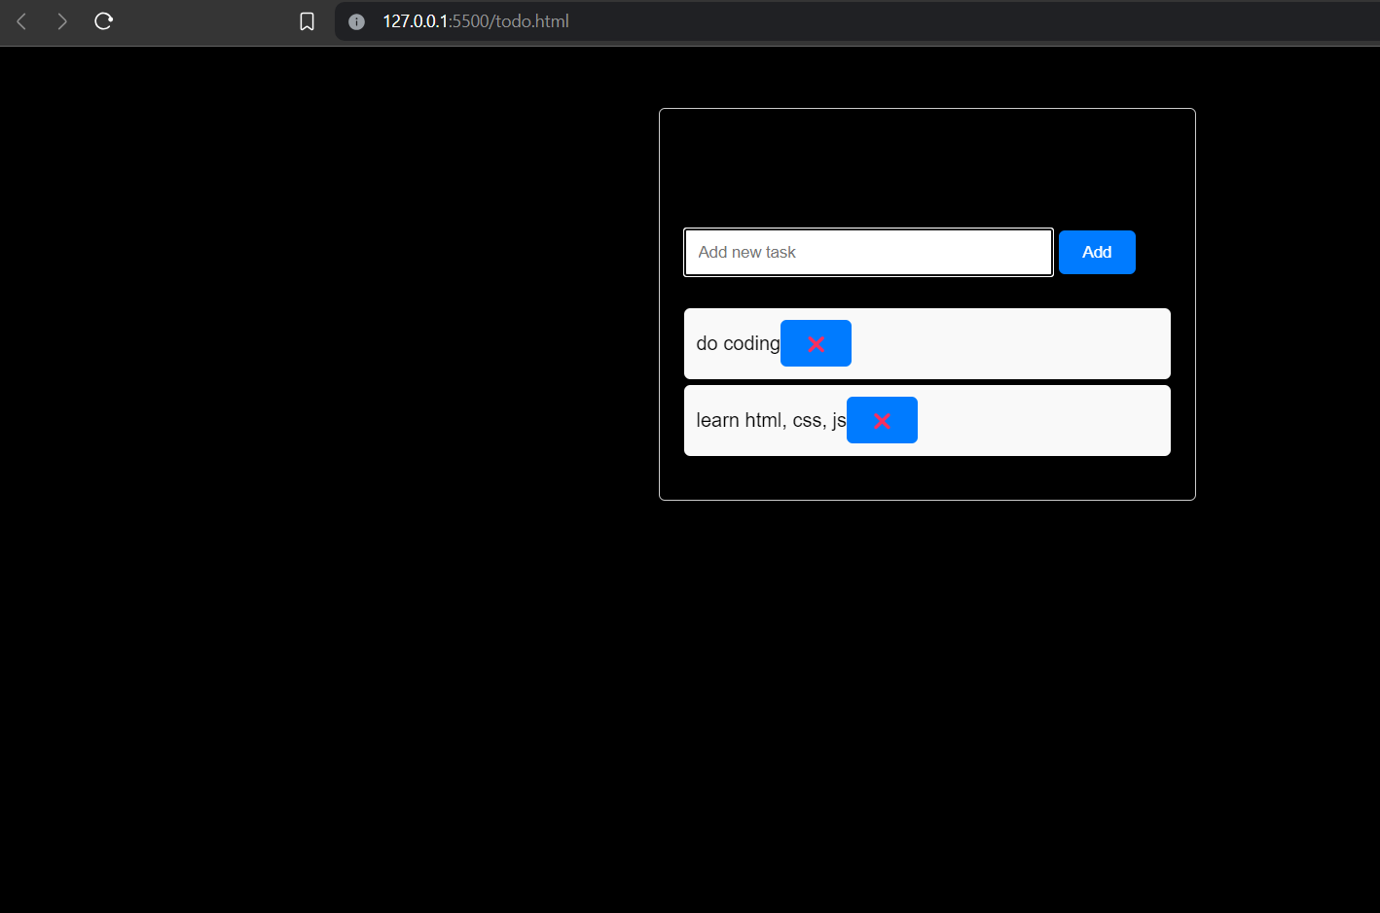

Slide 5
Uses
Personal Task Management: Individuals can use the application to keep track of their daily, weekly, or long-term tasks.
Team Collaboration: Teams or groups can utilize the shared task list feature to coordinate projects and assignments efficiently.
Educational Purposes: Students and learners can explore the basics of web development by studying and modifying the project code.

Slide 6
Advantages
Simplicity: The application's straightforward design makes it easy for users to understand and use without any learning curve.
Portability: Being a web-based application, it can be accessed from any device with a web browser, offering flexibility and convenience.
Customizability: While currently basic, the application's modular design allows for easy expansion and addition of new features as needed.

Slide 7
Disadvantages
Limited Functionality: Lacks advanced features found in dedicated task management tools, such as reminders, recurring tasks, and subtasks.
Data Persistence: Tasks are stored locally in the browser's memory, so they are lost when the browser is closed or refreshed.
Security Concerns: Without user authentication, anyone with access to the application can view and modify tasks, posing potential privacy risks.

Slide 8
Future Scope
User Authentication: Implement user accounts and authentication mechanisms to enable data persistence and user-specific task management.
Database Integration: Integrate a database backend to store tasks securely and provide reliable data persistence across sessions.
Enhanced Features: Add advanced features like due dates, priority levels, categorization, and task sorting/filtering options.
Improved UI/UX: Enhance the user interface with responsive design, animations, and interactive elements to improve user engagement.

Slide 9
Questions?:
Feel free to ask any questions or share your thoughts on the project.
Suggestions for Improvement?:
We welcome any suggestions or feedback to make the project better and more useful for users.

Slide 10


